Slide 1
[Dacon] Tutoring 3주차
박기찬

Slide 2
INDEX
2주차 복습
Resnet (다른 상위권 솔루션)
RNN

Slide 3
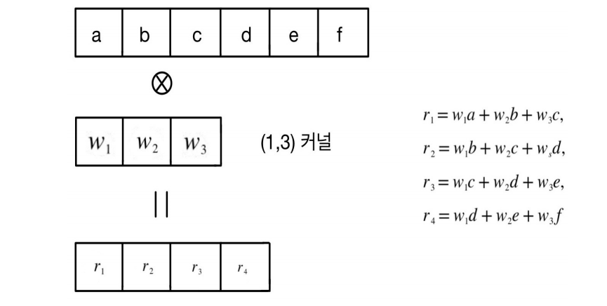
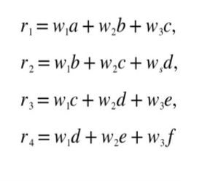
1. CNN
1. 입력은 (6,)인 1D tensor
2. Kernel size는 (1,3)
3. MLP와의 차이는?

Slide 4
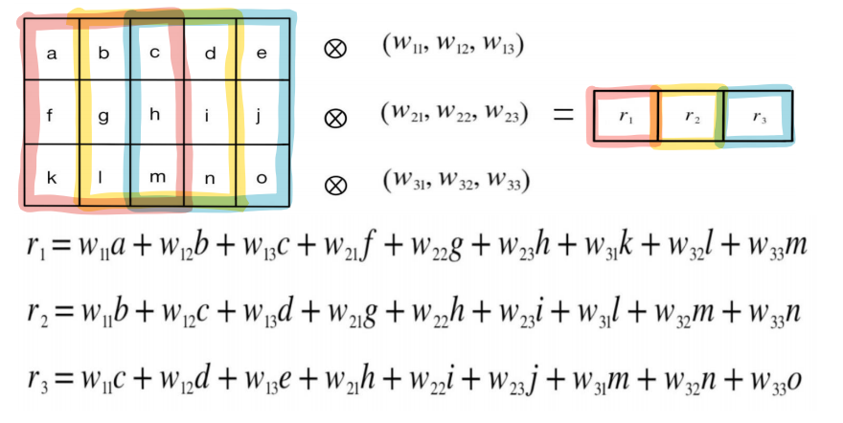
1. CNN
1. (, 3) 1D Conv 적용 예시

Slide 5
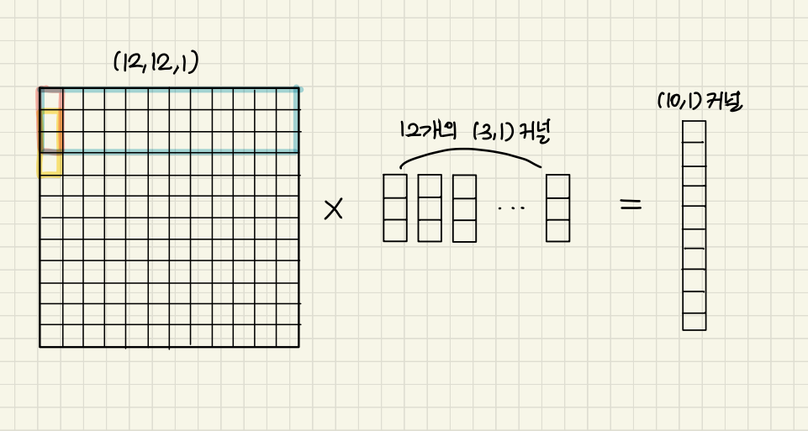
1. CNN
1. (3, ) 1D Conv 적용 예시

Slide 6
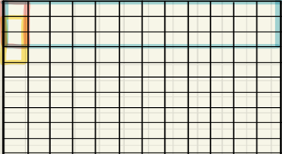
1. CNN
(10, 12) 커널
1개의 (3, 1) 커널
1. (3, 1) 2D Conv 적용 예시

Slide 7
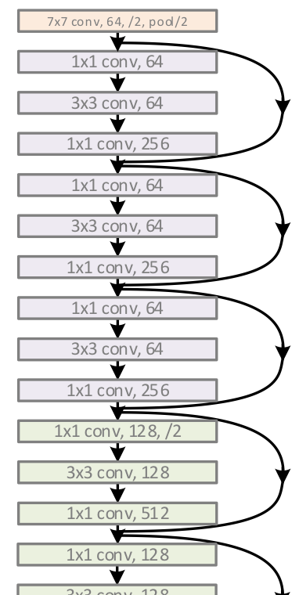
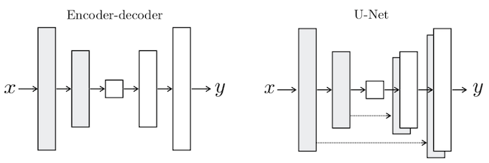
1. Resnet

Slide 8
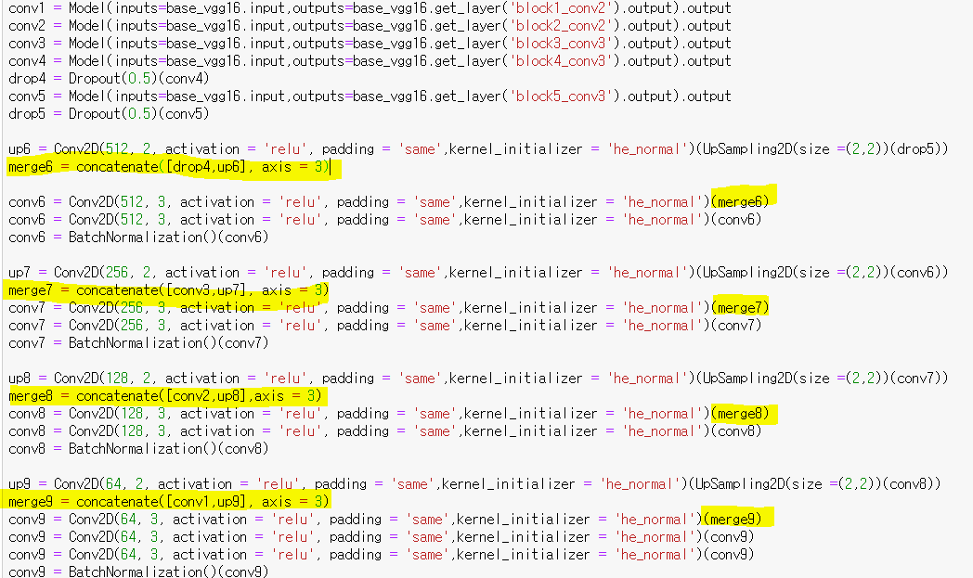
2. Resnet

Slide 9
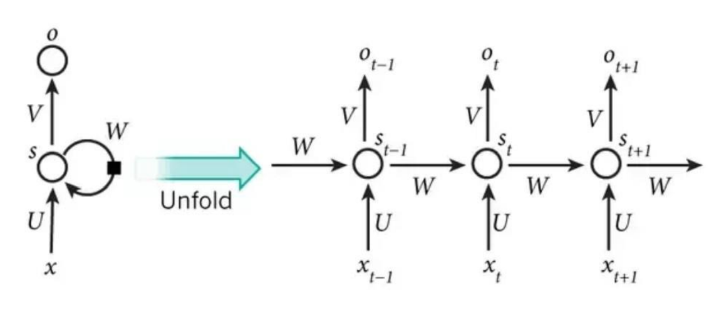
3. RNN

Slide 10
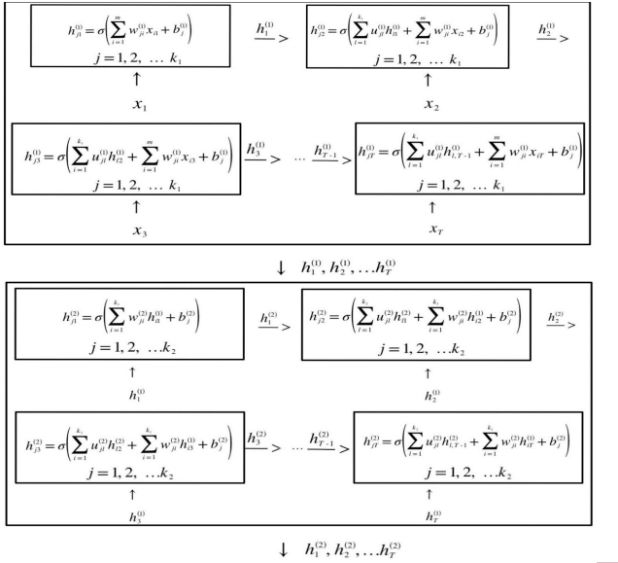
3. RNN

Slide 11
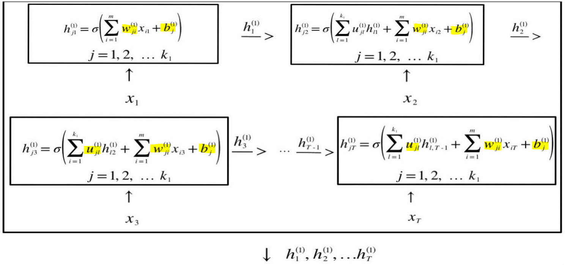
4. RNN

Slide 12
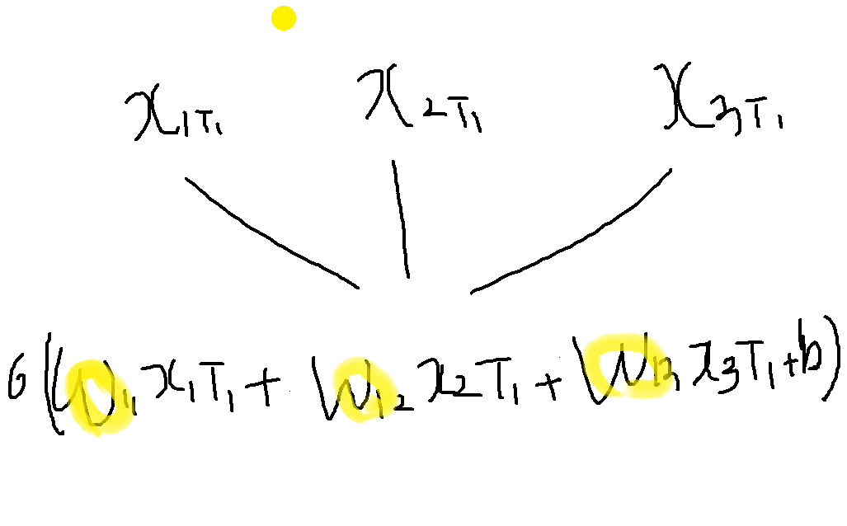
4. RNN

Slide 13
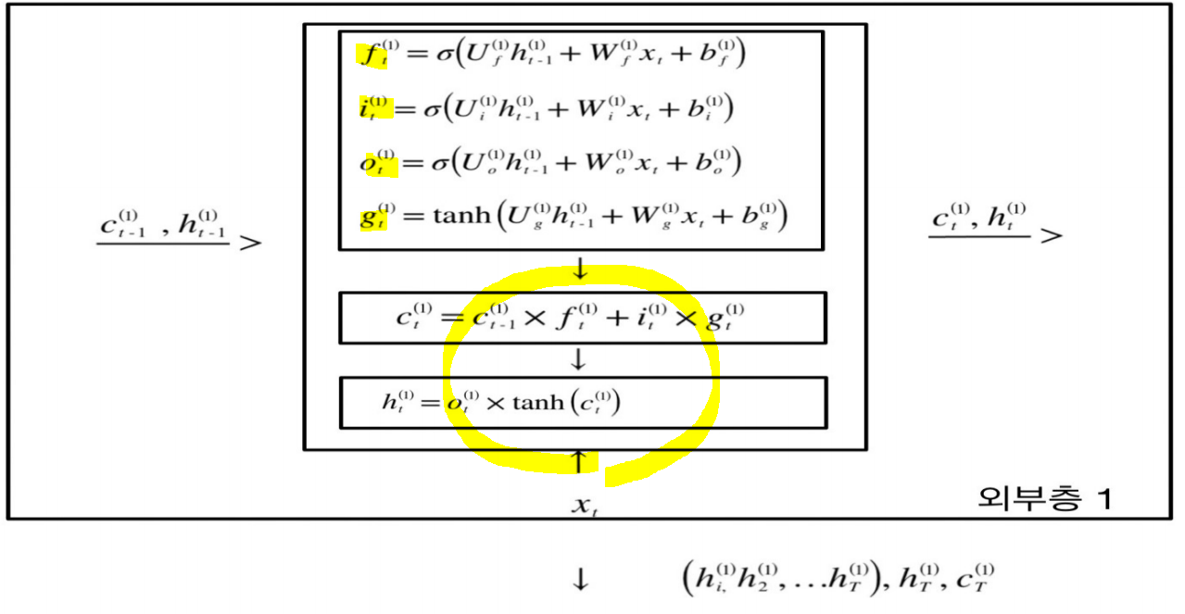
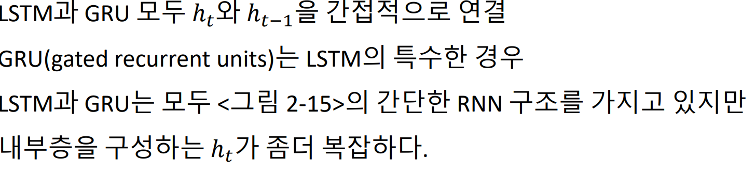
1. LSTM

Slide 14
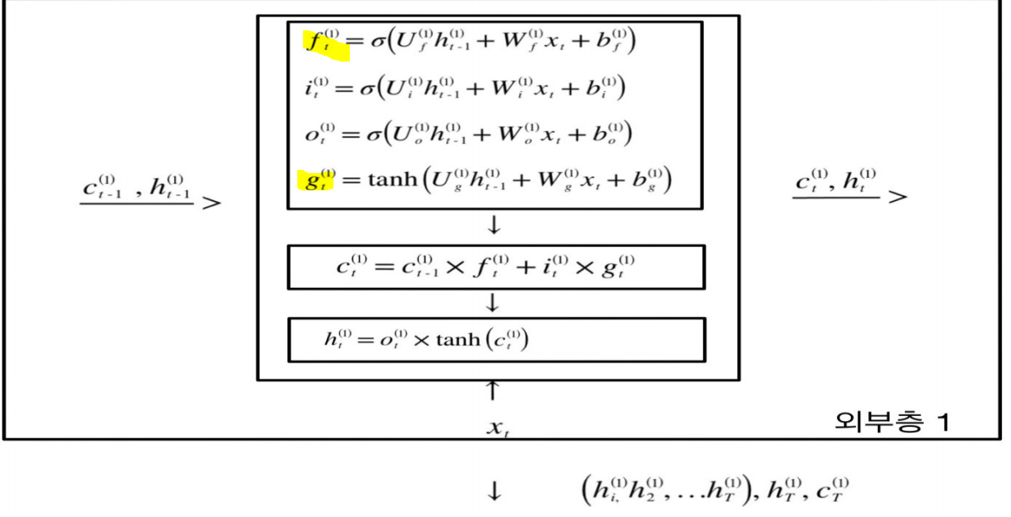

1. GRU

Slide 15
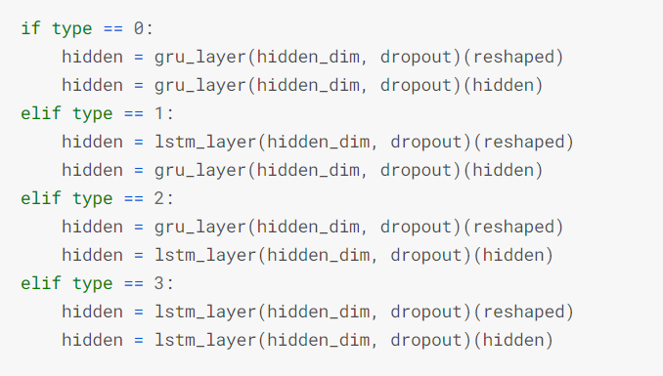
1. GRU
https://www.kaggle.com/its7171/gru-lstm-with-feature-engineering-and-augmentation

Slide 16
4. RNN

Slide 17
1. Modeling
Thank You

